Slide 1

BioCalc
Through the dark waters of the javascript inheritance
Alexandru Iuga
Braşov, September 2013

Slide 2
Agenda
Introduction
BioCalc Application
Function Call
Object Creation
Inheritance
© iQuest Group 2013. All rights reserved.

Slide 3
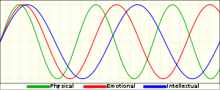

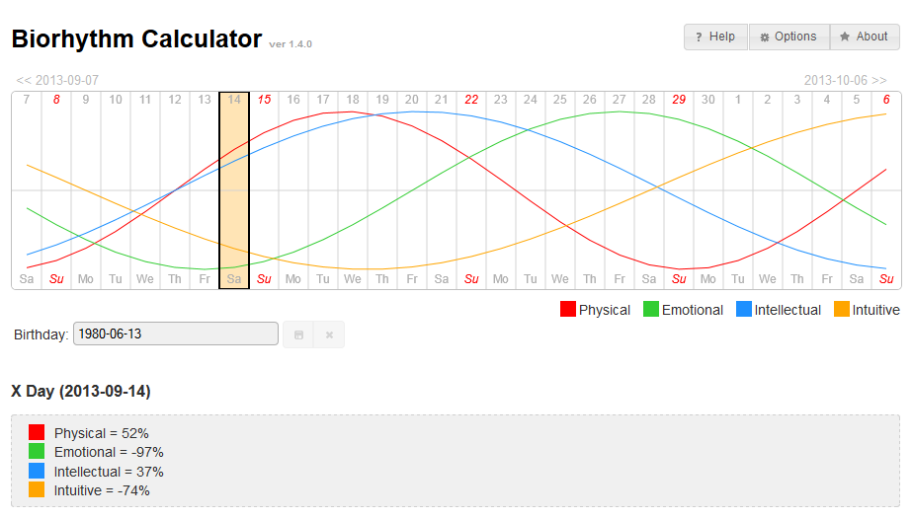
Introduction
What are the biorhythms?
http://en.wikipedia.org/wiki/Biorhythm
What is BioCalc?
[show in browser]
© iQuest Group 2013. All rights reserved.

Slide 4
Agenda
Introduction
BioCalc Application
Function Call
Object Creation
Inheritance
© iQuest Group 2013. All rights reserved.

Slide 5
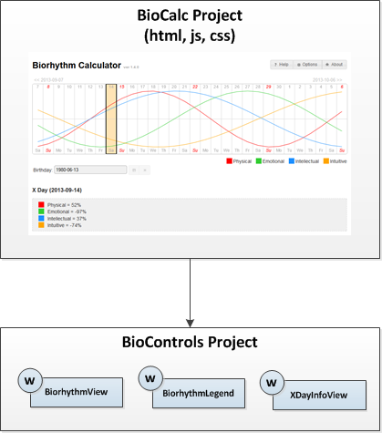
BioCalc Application
[show code]
© iQuest Group 2013. All rights reserved.

Slide 6
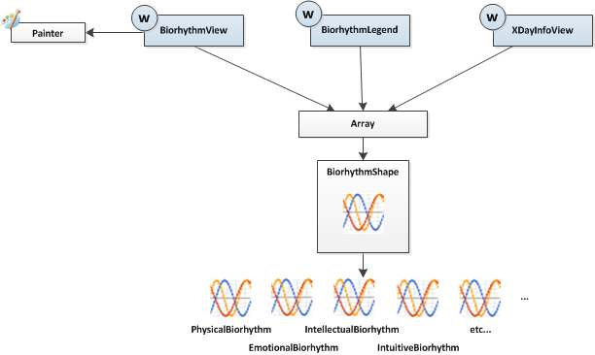
BioCalc Application – BioControls Project
BioControls Project
© iQuest Group 2013. All rights reserved.

Slide 7
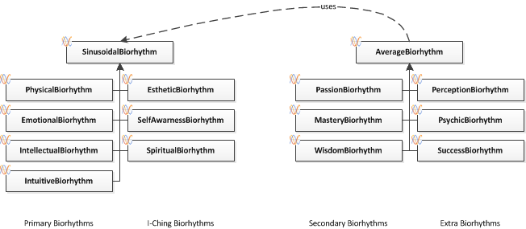
BioCalc Application
The Biorhythms hierarchy
[show code]
© iQuest Group 2013. All rights reserved.

Slide 8
Agenda
Introduction
BioCalc Application
Function Call
Object Creation
Inheritance
© iQuest Group 2013. All rights reserved.

Slide 9
Function Call
A function
function myFunction() {}
Call function
myFunction(); ⬄ myFunction.call(window);
myFunction.call(undefined); // ES5
myFunction(param); ⬄ myFunction.call(window, param);
myFunction.call(undefined, param); // ES5
Call function as method
var obj = {
myMethod: myFunction
};
obj.myMethod(); ⬄ myFunction.call(obj);
obj.myMethod(param); ⬄ myFunction.call(obj, param);
[jsfiddle:'this' in functions]
© iQuest Group 2013. All rights reserved.

Slide 10
Agenda
Introduction
BioCalc Application
Function Call
Object Creation
Inheritance
© iQuest Group 2013. All rights reserved.

Slide 11
Object Creation
1) Object literal
var cat = {};
2) Using new operator
function Cat() {}
var cat = new Cat();
3) Using the Object.create() function
var cat = Object.create(animal);
[jsfiddle: Different ways of creating objects]
© iQuest Group 2013. All rights reserved.

Slide 12
Agenda
Introduction
BioCalc Application
Function Call
Object Creation
Inheritance
© iQuest Group 2013. All rights reserved.

Slide 13
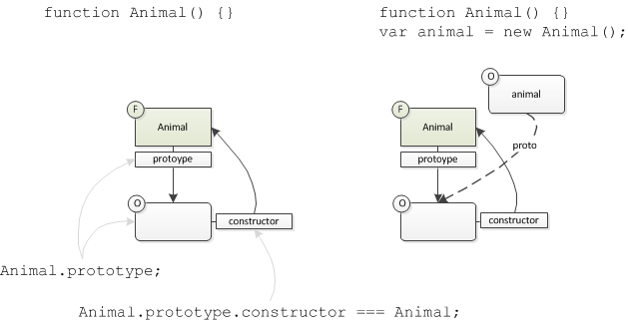
Inheritance – Explain notations
© iQuest Group 2013. All rights reserved.

Slide 14
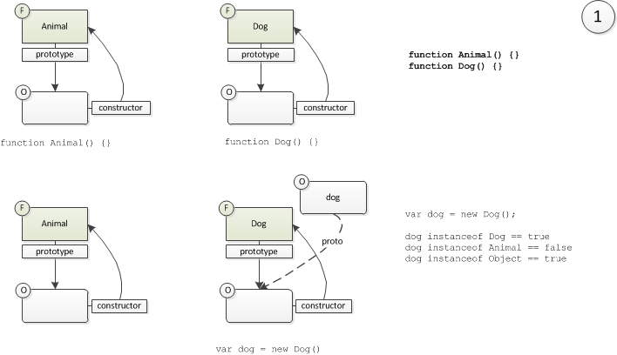
Inheritance – Basic
Create two functions (Animal and Dog)
© iQuest Group 2013. All rights reserved.

Slide 15
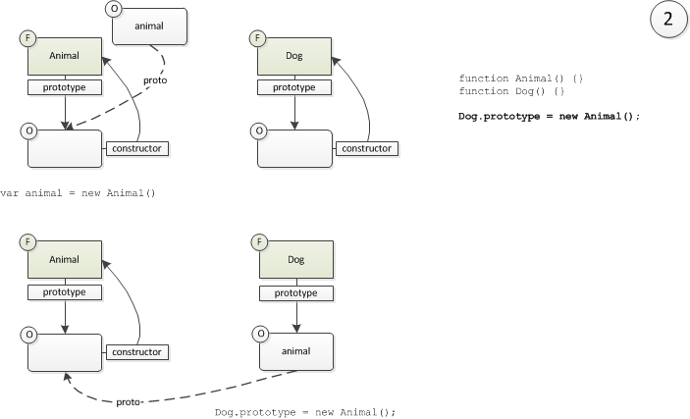
Inheritance – Basic
Set the prototype property of the Dog function
© iQuest Group 2013. All rights reserved.

Slide 16
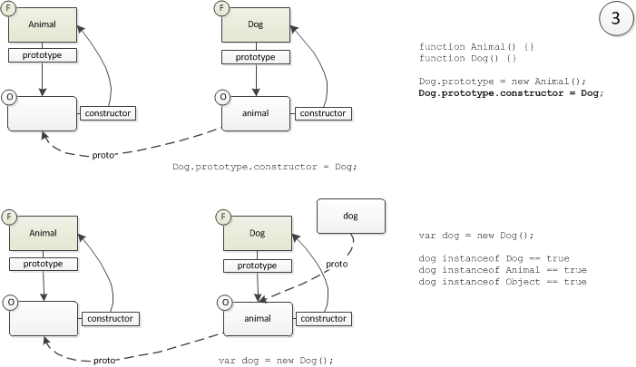
Inheritance – Basic
Fix the „constructor” property of the Dog function
But what if...
[jsfiddle: Inheritance - basic]
© iQuest Group 2013. All rights reserved.

Slide 17
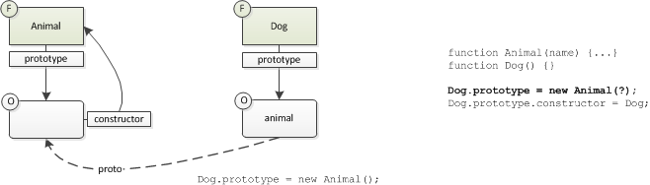
Inheritance – Basic
... The prototype’s constructor has parameters
We cannot call the Animal constructor here.
© iQuest Group 2013. All rights reserved.

Slide 18
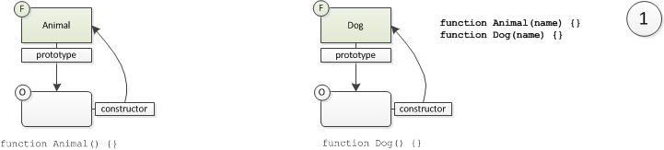
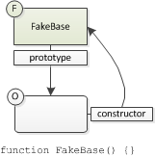

Inheritance – With Parameters
Create the constructor function named FakeBase
We’ll use the parameterless FakeBase constructor instead of the Animal constructor.
© iQuest Group 2013. All rights reserved.

Slide 19
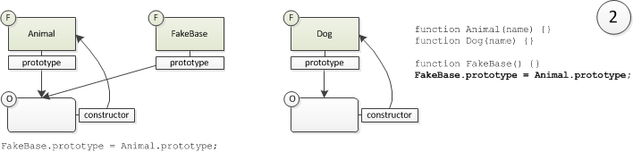
Inheritance – With Parameters
Set the prototype property of the FakeBase function
© iQuest Group 2013. All rights reserved.

Slide 20
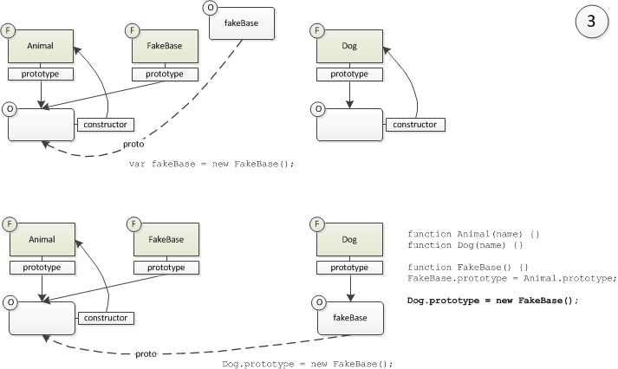
Inheritance – With Parameters
Set the prototype property of the Dog function
© iQuest Group 2013. All rights reserved.

Slide 21
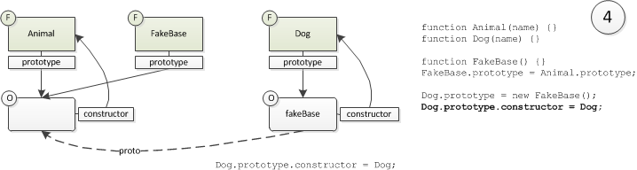
Inheritance – With Parameters
Fix the „constructor” property of the FakeBase function
© iQuest Group 2013. All rights reserved.

Slide 22
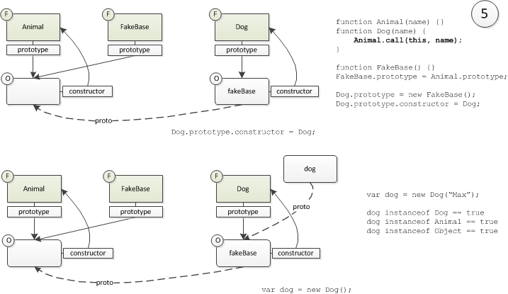
Inheritance – With Parameters
Call base constructor.
© iQuest Group 2013. All rights reserved.

Slide 23
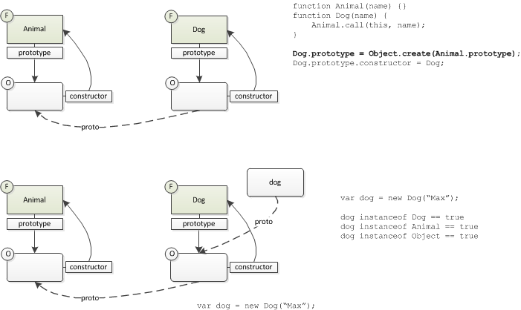
Inheritance – With Parameters
In ECMA Script 5
[jsfiddle: Inheritance - with params]
© iQuest Group 2013. All rights reserved.

Slide 24
Inheritance – Conclusion
Inheritance – no params
function Animal() {}
function Dog() {}
Dog.prototype = new Animal();
Dog.prototype.constructor = Dog;
Inheritance – with params
function Animal(name) {}
function Dog(name) {
Animal.call(this, name);
}
Dog.prototype = Object.create(Animal.prototype);
Dog.prototype.constructor = Dog;
[show code: Biorhythm inheritance]
© iQuest Group 2013. All rights reserved.

Slide 25
Links
Wikipedia Biorhythm page:
http://en.wikipedia.org/wiki/Biorhythm
BioCalc Github page:
https://github.com/lastunicorn/BioCalcJs
or
http://github.com -> search for BioCalc
© iQuest Group 2013. All rights reserved.

Slide 26

The end
© iQuest Group 2013. All rights reserved.

